Slide 1
Prelim 1 Review
Prelim 1 Tuesday October 17
7:30 pm in 318 Phillips

Slide 2
General Question
Test format: What types of questions should we expect?
7 multiple choice questions (4 points each)
Short problems (includes one graph)
How far should we be able to extrapolate beyond what is in the notes?
You should understand the fundamental concepts and be able to talk about those concepts with your friends
Algebra and arithmetic are expected

Slide 3
Python based Prelim
What could fail?
No communication with other humans during the exam
No posting questions or answers on the web
Delete part of the exam by mistake (save a copy with your name in the title as step 1)
How do you minimize risk of failure?
Save versions
Also submit a pdf copy. Print the webpage as a pdf (File – print preview, then print as pdf)

Slide 4
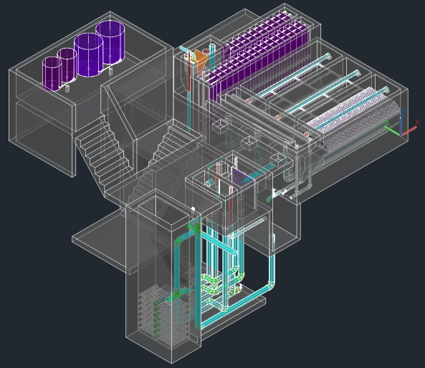

Slide 5
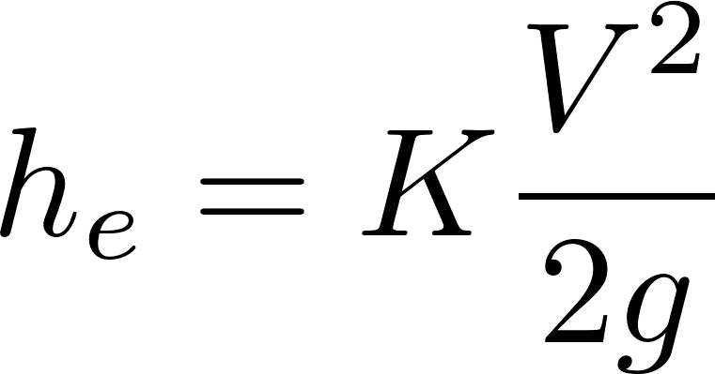
What are examples of major and minor losses?
Major: Caused by shear with the solid surface
Pipe walls
Flocculator baffle surfaces (insignificant)
Minor: Flow expansions (analogous to pressure drag)
Orifice, elbow, valve, any place where flow is expanding!
KE is converted into 2 things!
Velocity
Shear (wall on fluid)

Slide 6
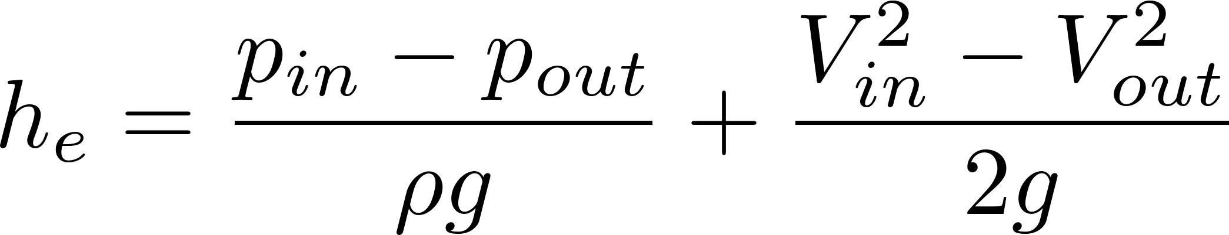
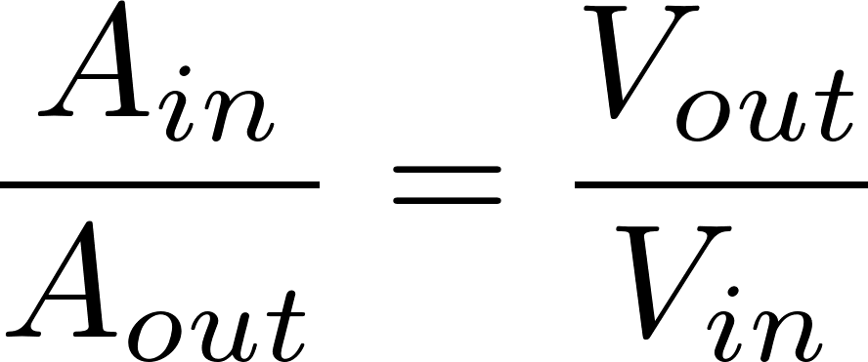
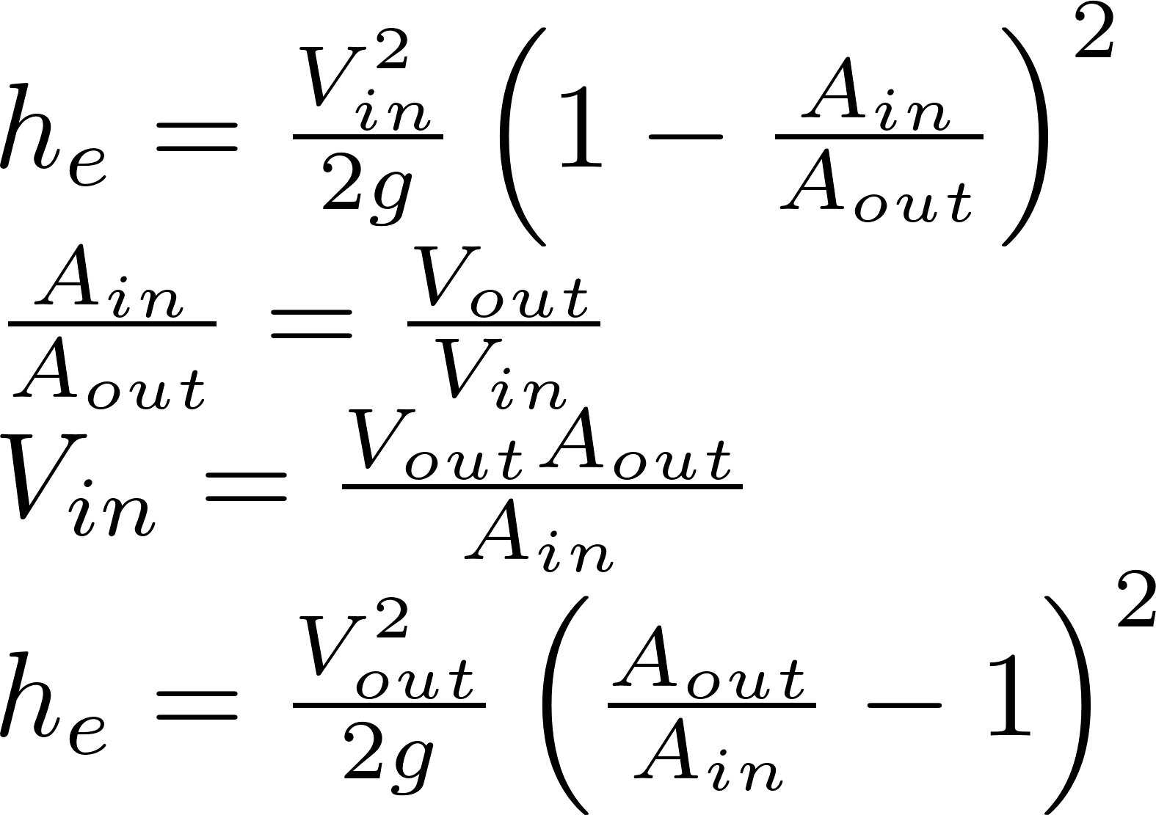
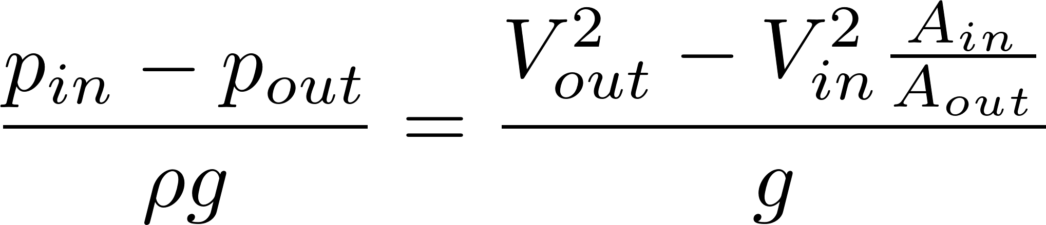
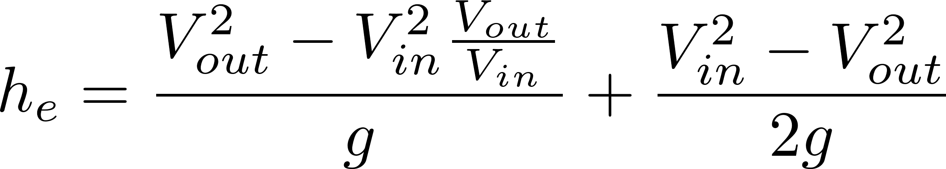
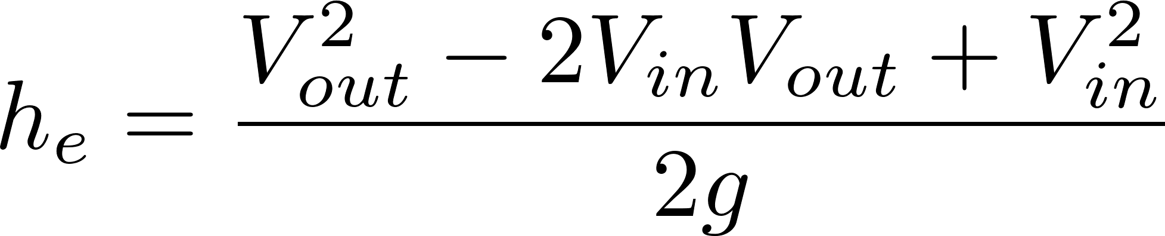
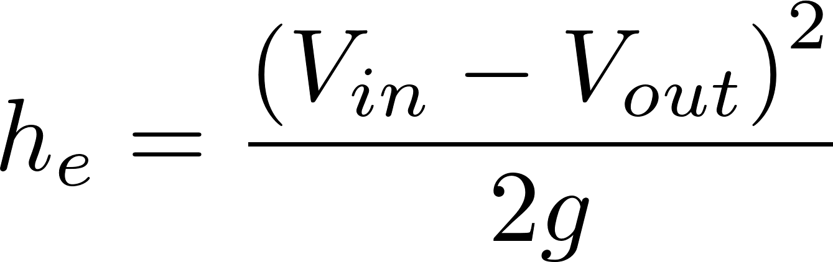
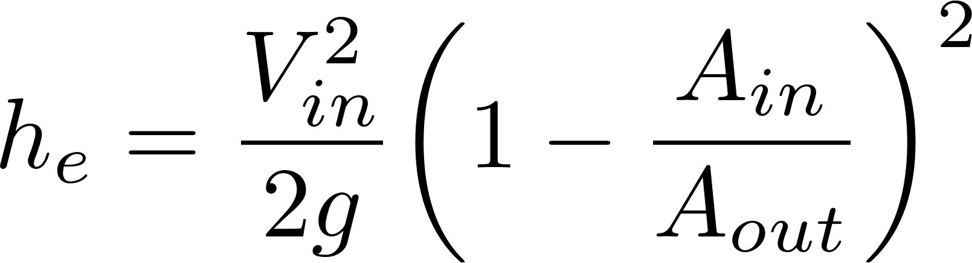
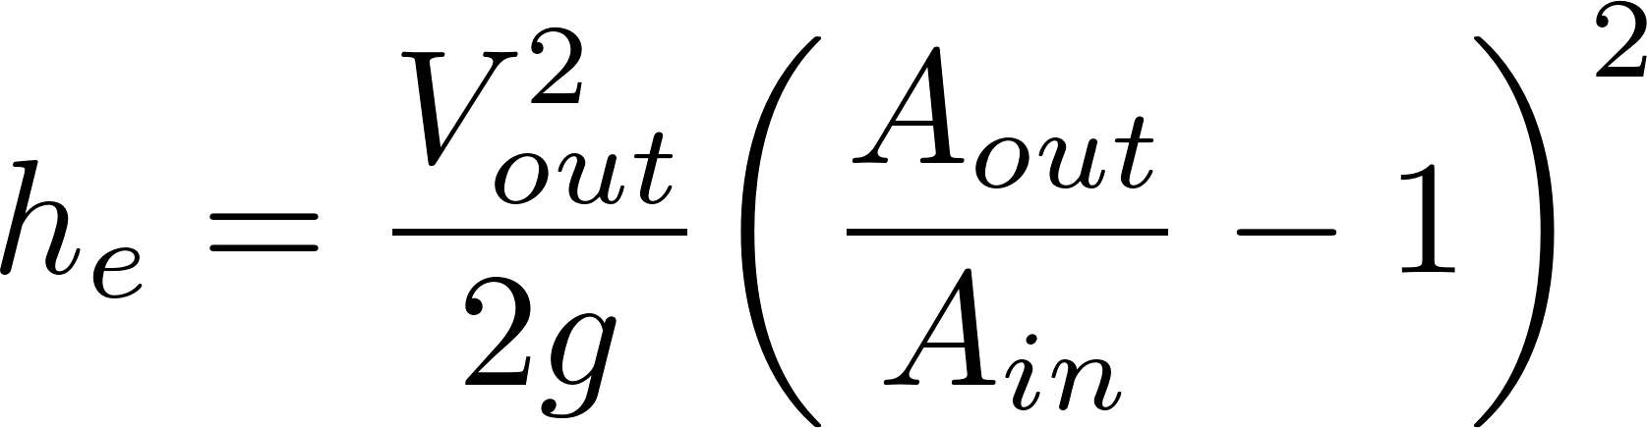
Head Loss due to Sudden Expansion
Energy
Mass
Momentum
2
2
2
K_{e}
K_{e}’
Discharge into a reservoir?__________________
Loss coefficient = 1
Notes:
Emphasize the minor loss coefficient is defined based on some relevant velocity. We can chose either V1 or V2. But the magnitude of the minor loss coefficient is determined by which velocity we use. We need to choose one and be consistent. The velocity that we choose will be a function of convenience. Minor losses are proportional to the square of the velocity. This is true whether the flow is turbulent or laminar!

Slide 7
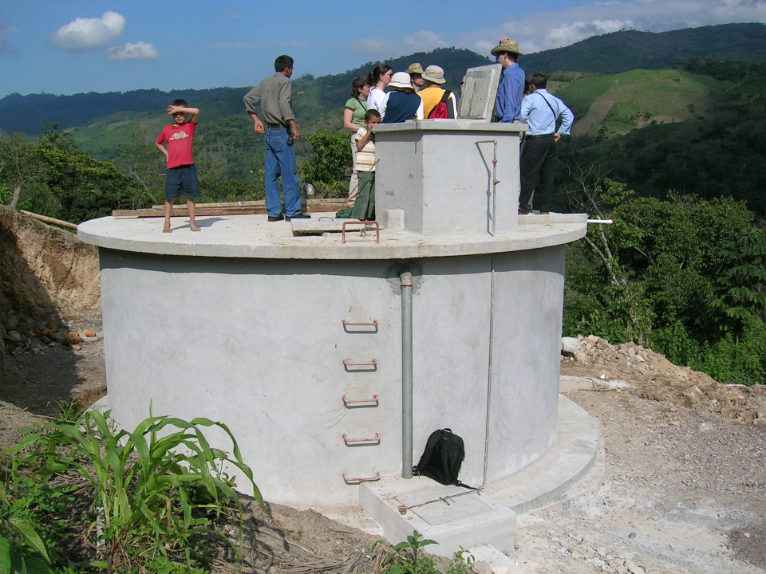

The Challenge of Chemical Metering (Hypochlorinator)
What is the simplest representation that captures the fluid mechanics of this system?
Access door to hypochlorinator tank
Overflow tube
Chlorine solution
Access door to distribution tank
PVC valve
PVC pipe
Chlorine drip
Raw water entering distribution tank

Slide 8
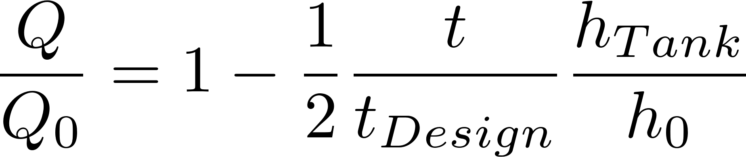
Hole in a bucket (tank drain)
What type of head loss (major or minor)?
What is the equation for those loses?
How would you calculate the initial flow rate given the minor losses?
How does the flow vary with time?
What is the average flow rate while the tank is emptying?
Notes:
Minor
Minor loss equation
Solve for V and note that Q=VA
Flow decreases linearly with time
Average Q is ½ of initial Q.

Slide 9
Hole in a bucket (tank drain)
Case 2, h₀=1 m, h_{tank} = 1 m, t_{design}=4 days

Slide 10
What happens if raw water temperature drops in a WTP?
Flow measurement
Chemical feed (air temperature?)
Rapid mix
Flocculation
Head loss through flocculator
Fluid deformation (Gθ)
Sedimentation – prelim 2!
Notes:
Flow measurement (no change in minor head loss)
Chemical feed (air temperature?) If stock chemicals chill, then increased viscosity gives lower chemical flow rate.
Rapid mix (both diffusion and fluid deformation will slow down)
Flocculation
Head loss through flocculator (no change)
Fluid deformation (Gθ) (decrease in G)
Sedimentation (decrease in sedimentation rate)

Slide 11
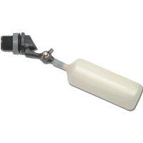
Constant head tank
Stock Tank of coagulant
Lever
Slider
H
Float valve
LFOM
Open channel supercritical flow
Drop tube
Float
Dosing tubes
Purge valves
Notes:
Why is Q vs depth of water linear for the entrance tank?
Why is Q vs H linear for the coagulant?

Slide 12
Decrease dose
H

Slide 13
Increase dose
H

Slide 14
Half flow
H

Slide 15
Plant off

Slide 16
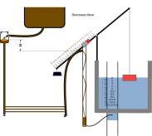
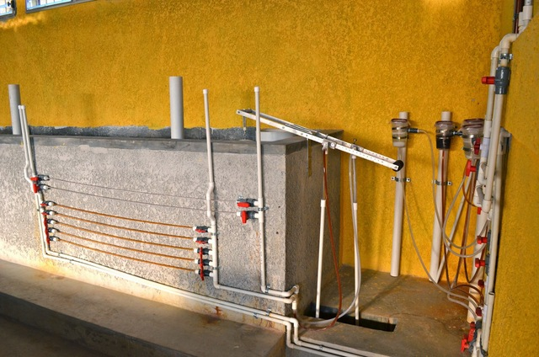
Where is this equipment in the new design?

Slide 17
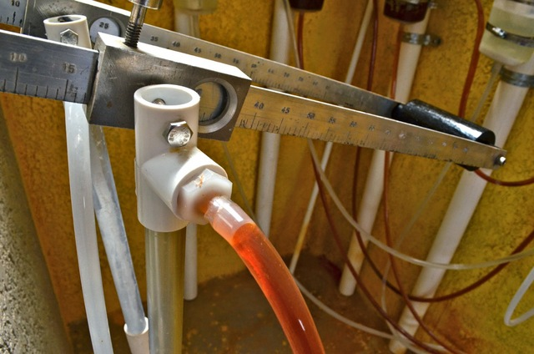

Slide 18
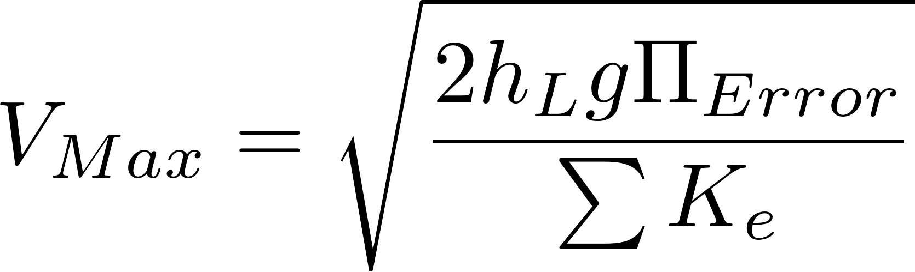
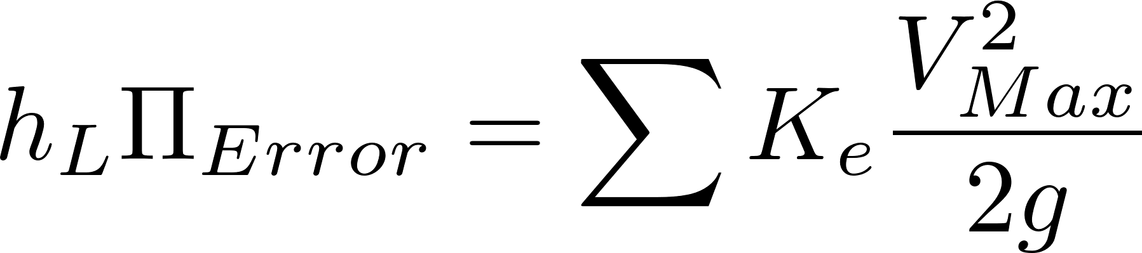
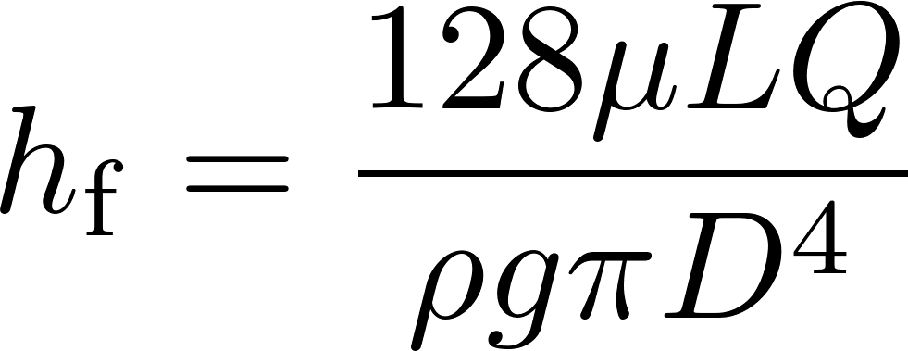
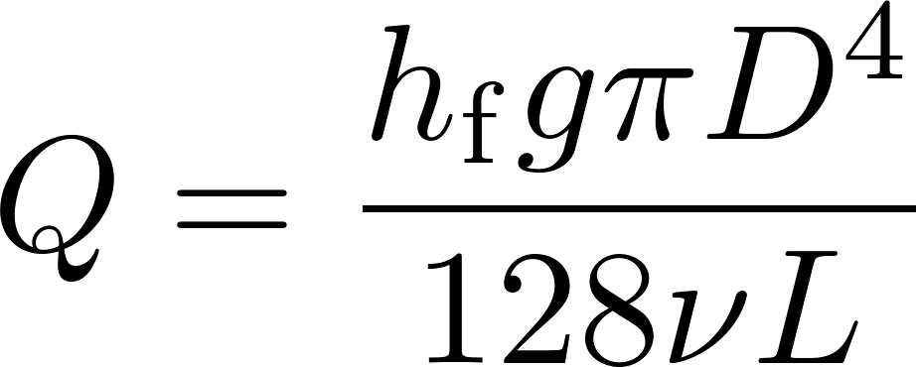
Chemical Dose Controller
What is the purpose of CHT?
What is the purpose of the dosing tubes?
What is the design constraint for the maximum flow rate in the dosing tubes?
Why does the flow through the dose controller increase if the plant flow rate increases?

Slide 19
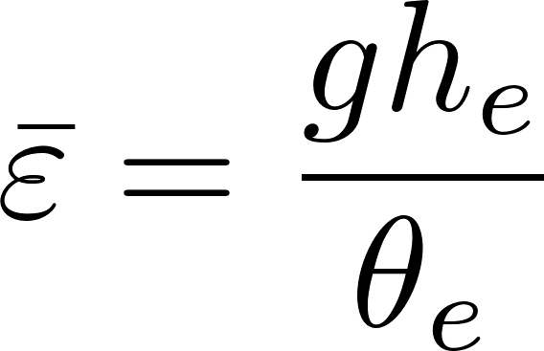
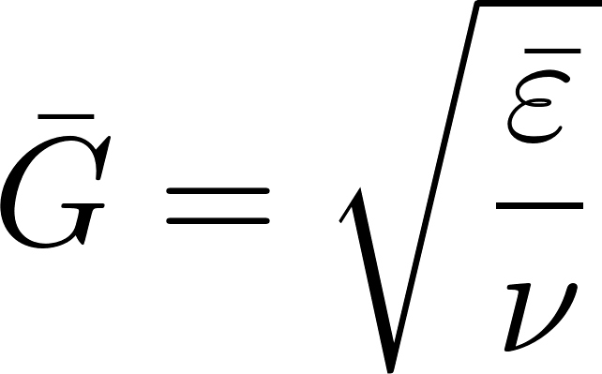
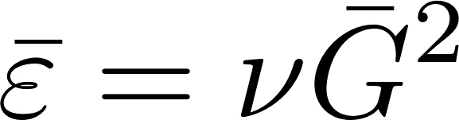
Head loss, energy dissipation rate, velocity gradient
Use these equations to relate velocity gradient to velocity (and then to flow geometry)

Slide 20
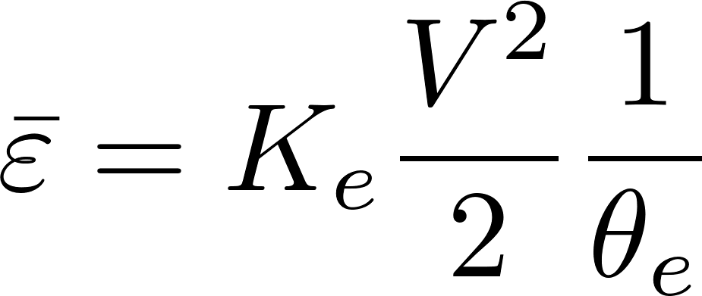
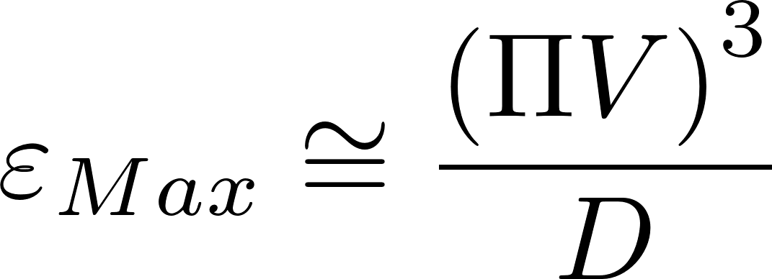
Energy dissipation rate
ε | Equation source | Equation | scale
Ave | Control volume mass momentum energy |  | time over which energy is dissipated
Max | Dimensional analysis |  | Flow dimension

Slide 21
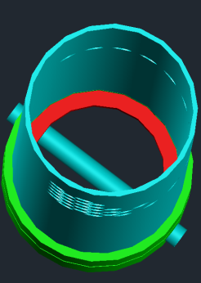
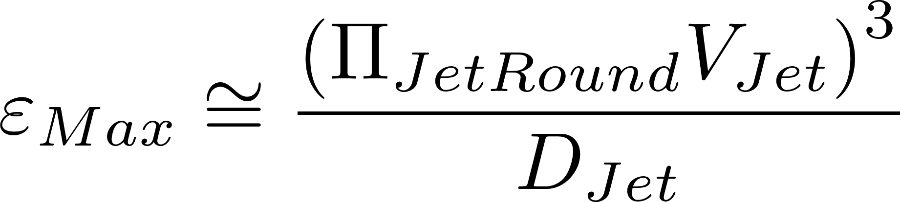

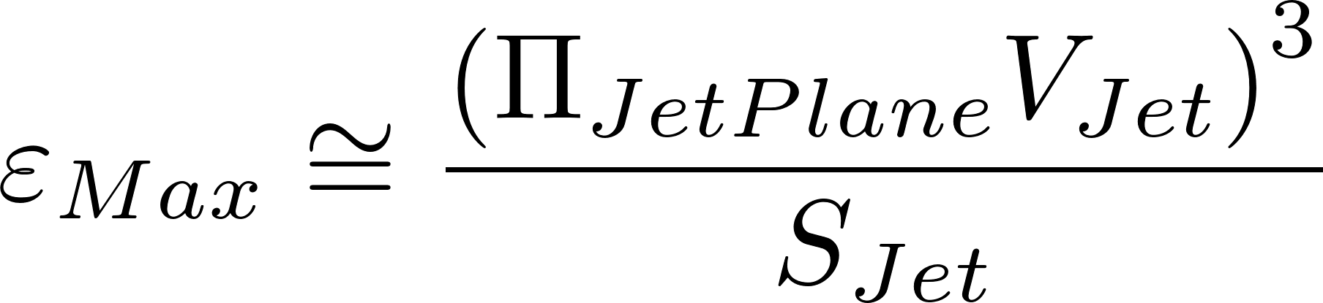
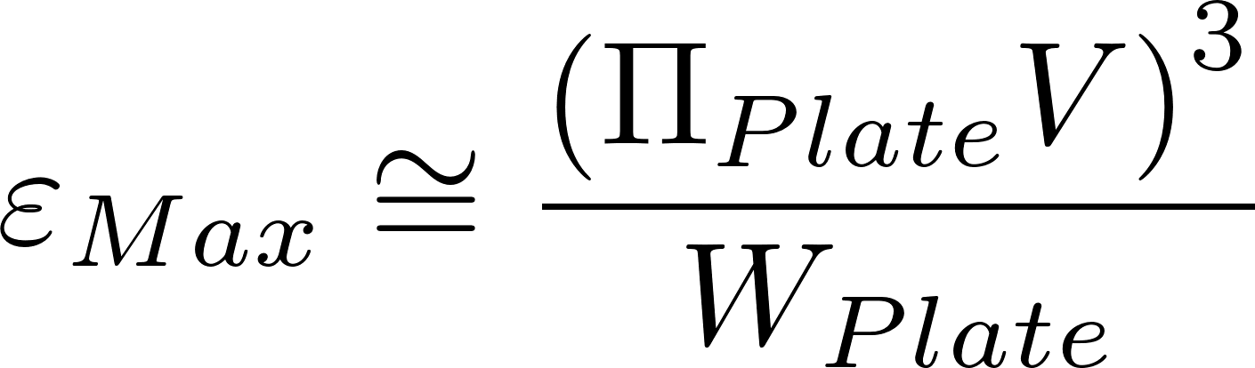
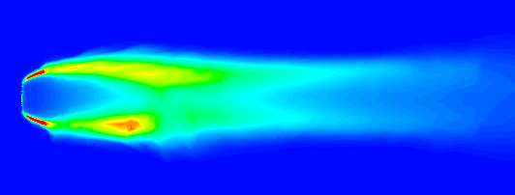
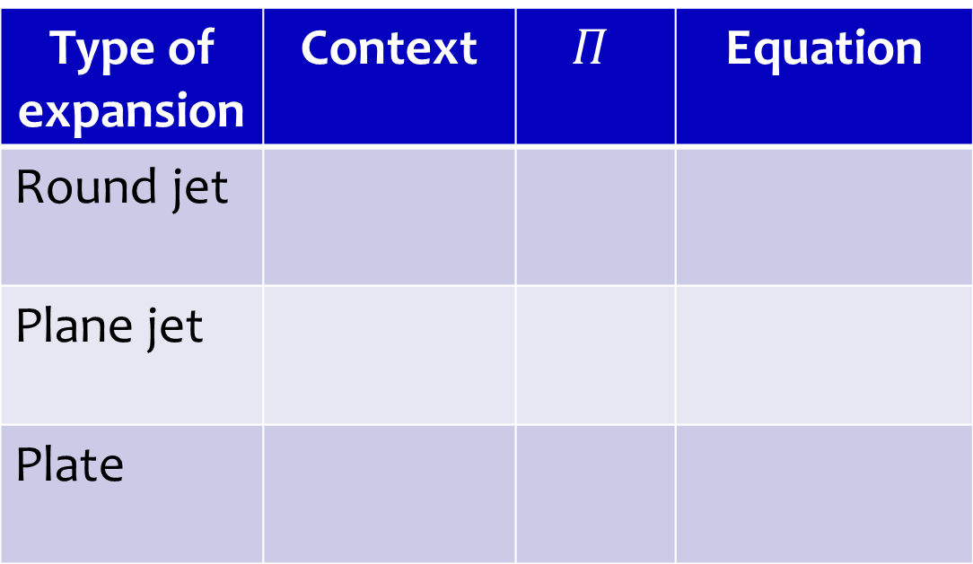
Maximum Energy Dissipation Rate
Type of expansion | Context | $$Π$$ | Equation
Round jet
Plane jet
Plate
Rapid mix
0.5
Hydraulic flocculator
0.225
Mechanical flocculator
0.34

Slide 22
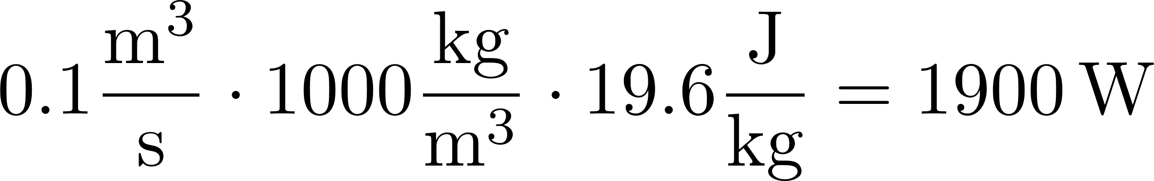
Power and Energy
Energy: Joule = Newton*meter
Power: Watt = Joule/s
Water elevation change in an AguaClara plant is about 2 m. How much energy are we using per kg of water?
If the flow rate is 100 L/s, what is the equivalent power?
Desalination = 1 km, distillation = 250 km
2m*g = 19.6 (m/s)^2 = J/kg
Notes:
2m*g = 19.6 (m/s)^2 = J/kg
0.1m^3/s*1000kg/m^3*19.6J/kg = 1.9 kW

Slide 23
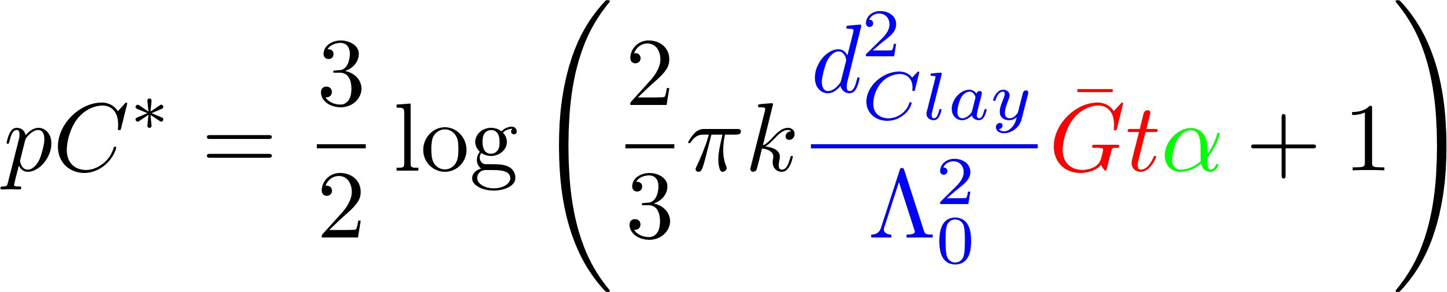
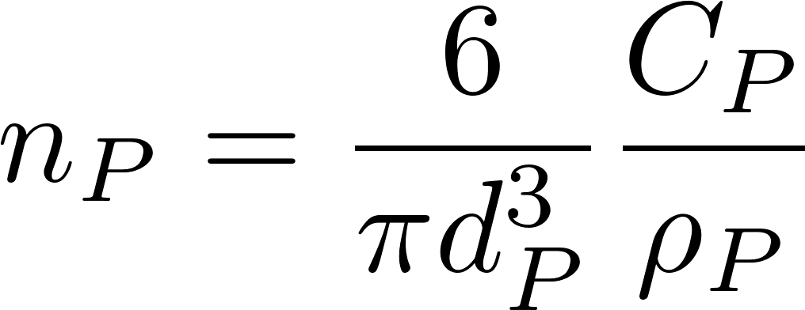
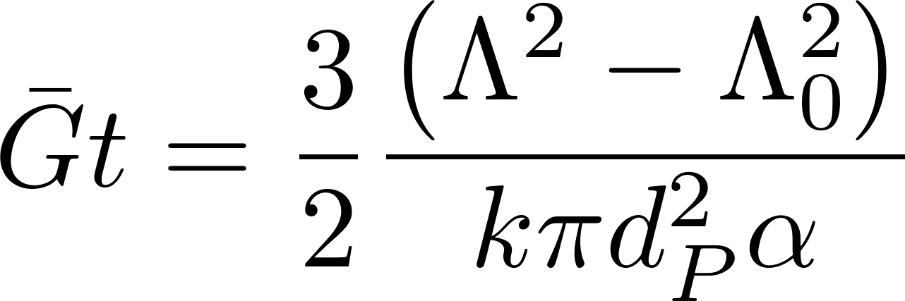
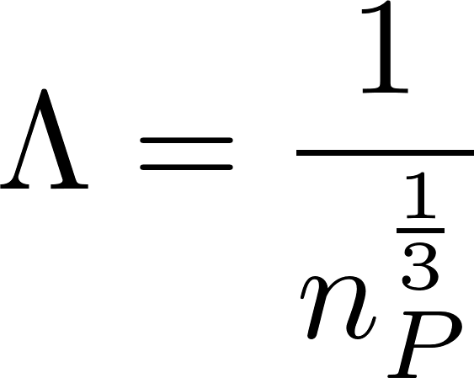
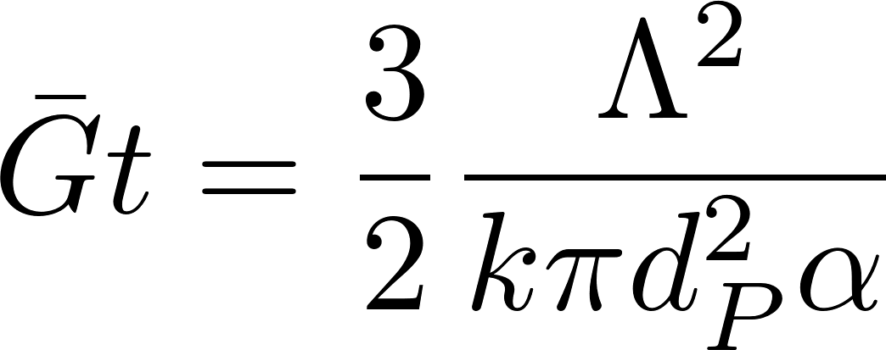
Identify all of the parameters in the Floc Model

